Slide 1
martin.reid@solent.ac.uk
ALERTS & NOTIFICATIONS
Computing - Faculty of Business, Law and Digital Technologies - Solent University – Southampton

Slide 2
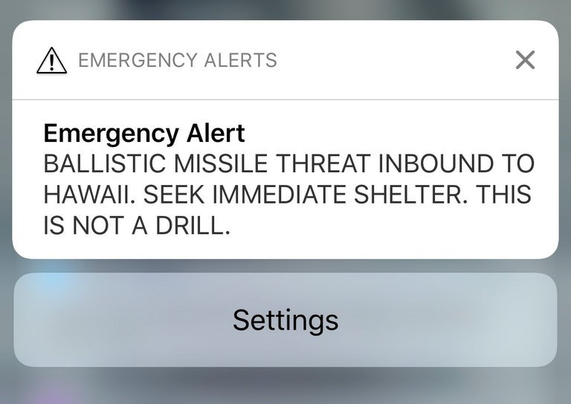

Slide 3
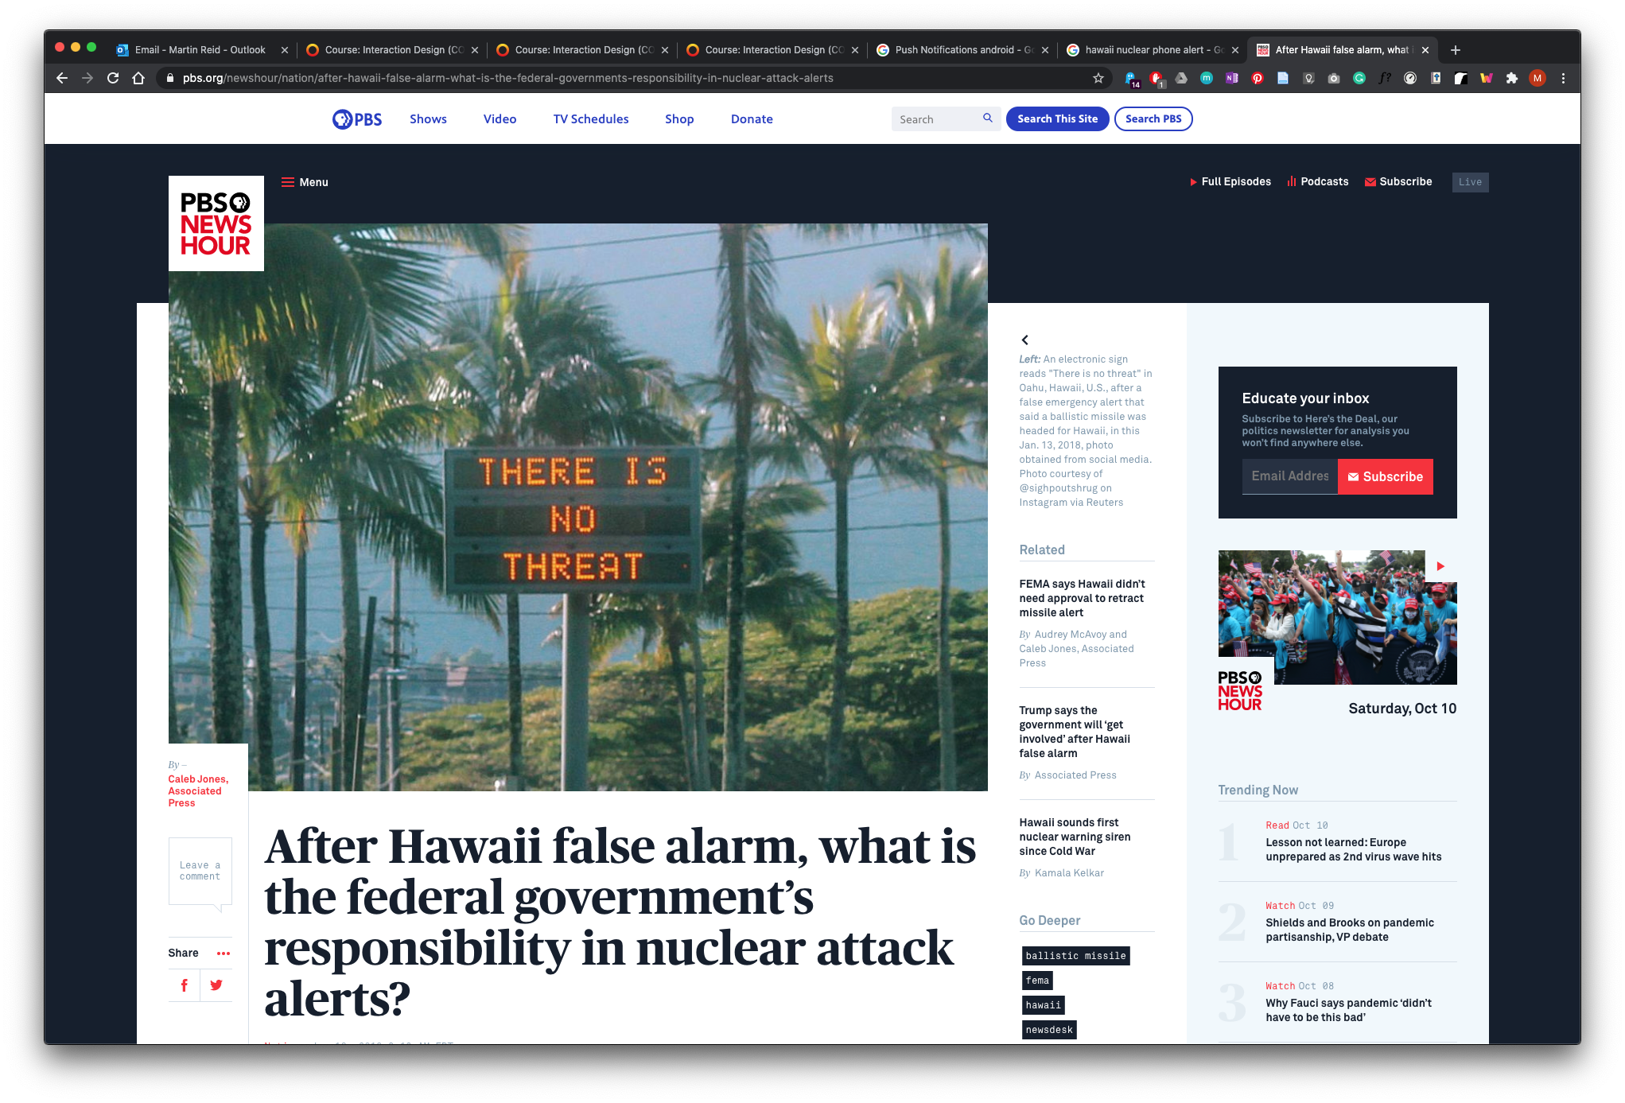
PBS., 2018. After Hawaii false alarm, what is the federal government’s responsibility in nuclear attack alerts? [viewed 11 October 2020]. Available from: https://www.pbs.org/newshour/nation/after-hawaii-false-alarm-what-is-the-federal-governments-responsibility-in-nuclear-attack-alerts

Slide 4
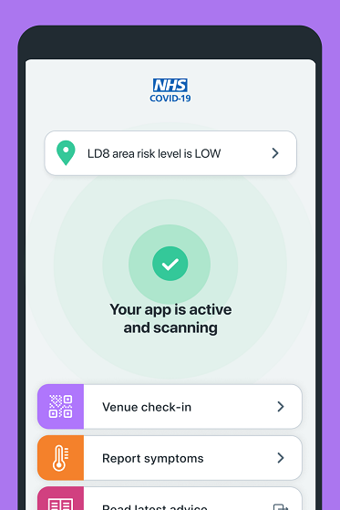
NHS., 2020. NHS COVID-19 - NHS [viewed 11 October 2020]. Available from: https://www.nhs.uk/apps-library/nhs-covid-19/

Slide 5
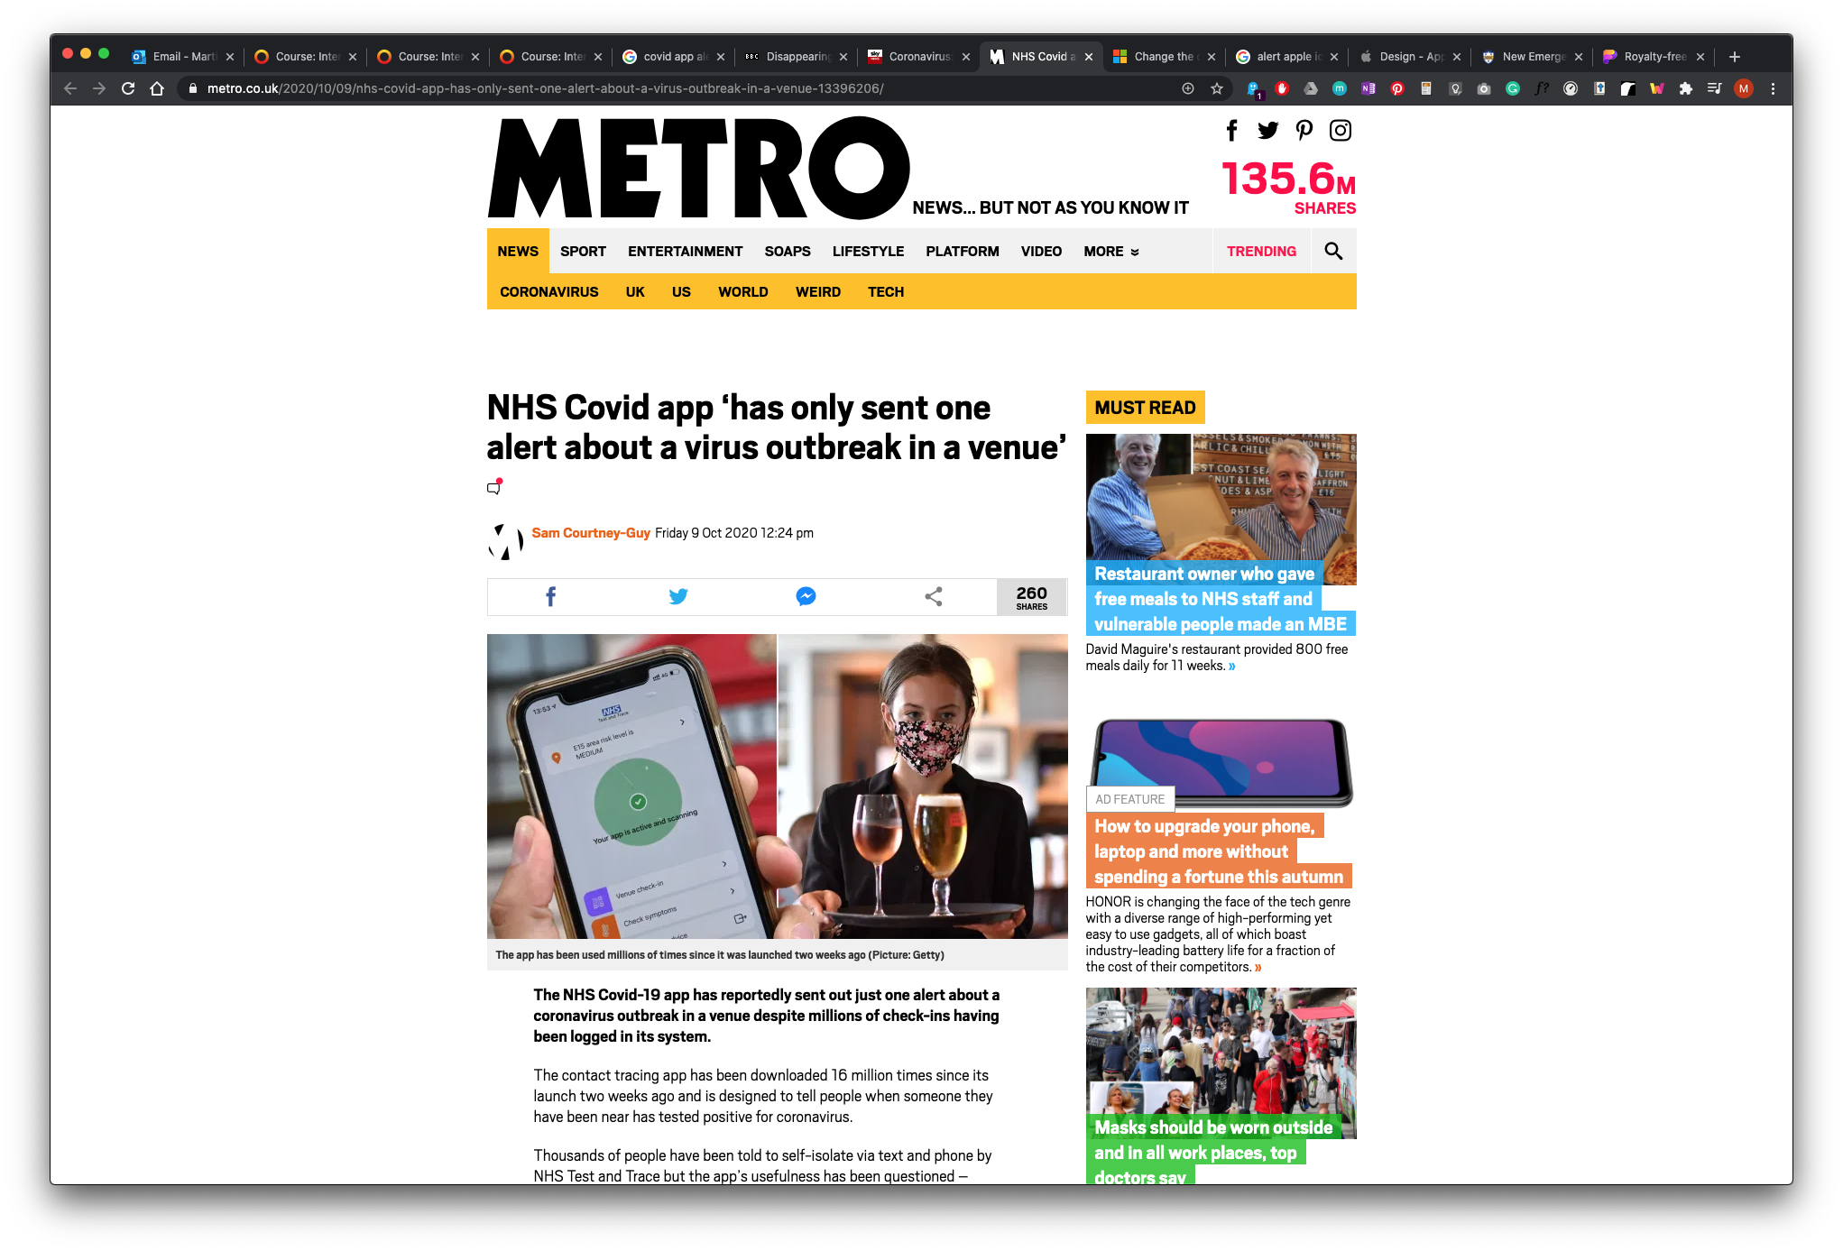
METRO., 2020. NHS Covid app ‘has only sent one alert about a virus outbreak in a venue’. In: Metro. 9 October 2020 [viewed 11 October 2020]. Available from: https://metro.co.uk/2020/10/09/nhs-covid-app-has-only-sent-one-alert-about-a-virus-outbreak-in-a-venue-13396206/

Slide 6
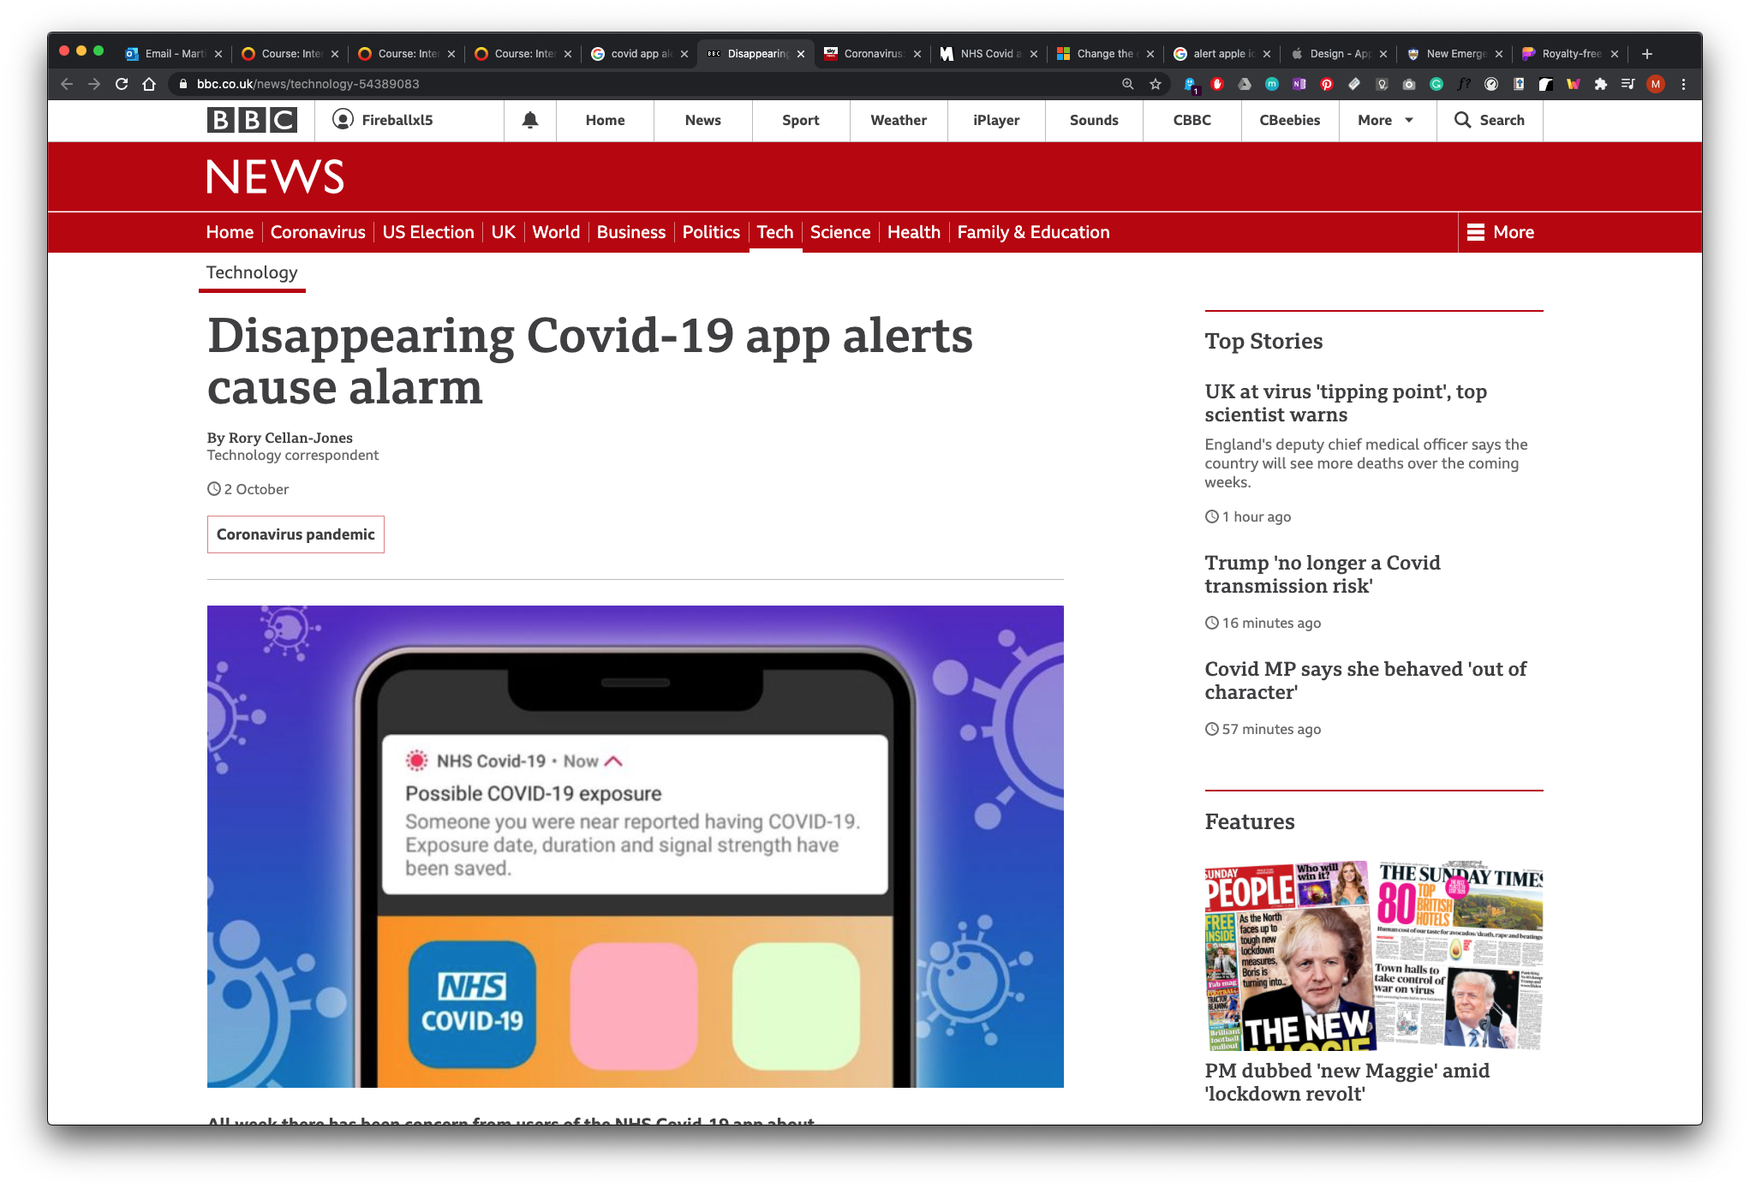
"All week there has been concern from users of the NHS Covid-19 app about disturbing alerts that quickly vanish."
(BBC NEWS 2020)
BBC., 2020. Disappearing Covid-19 app alerts cause alarm. BBC News, 2 Oct https://www.bbc.co.uk/news/technology-54389083

Slide 7
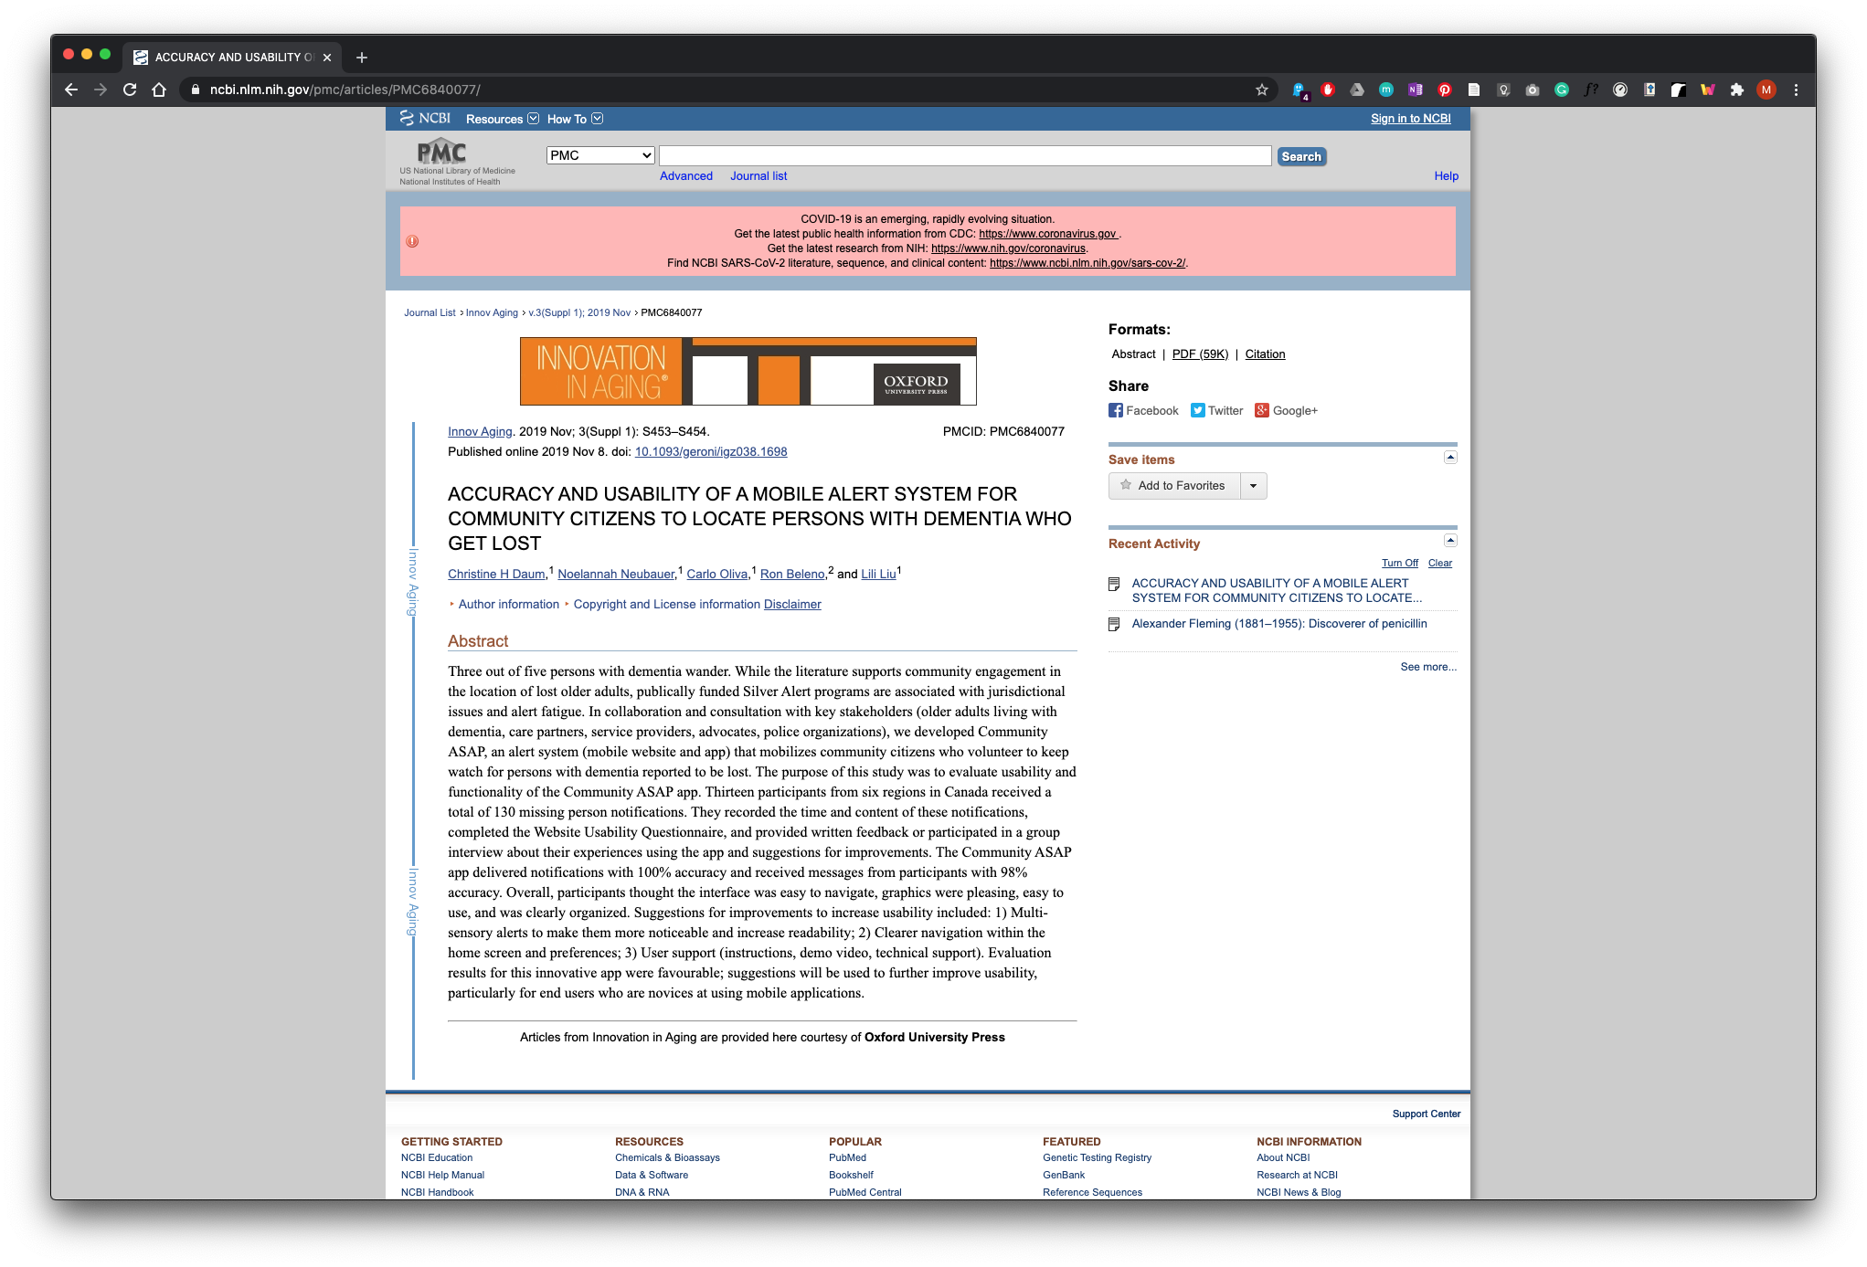
DAUM, C.H. et al., 2019. ACCURACY AND USABILITY OF A MOBILE ALERT SYSTEM FOR COMMUNITY CITIZENS TO LOCATE PERSONS WITH DEMENTIA WHO GET LOST. Innovation in Aging, 3(Suppl 1), S453–S454 doi: 10.1093/geroni/igz038.1698

Slide 8
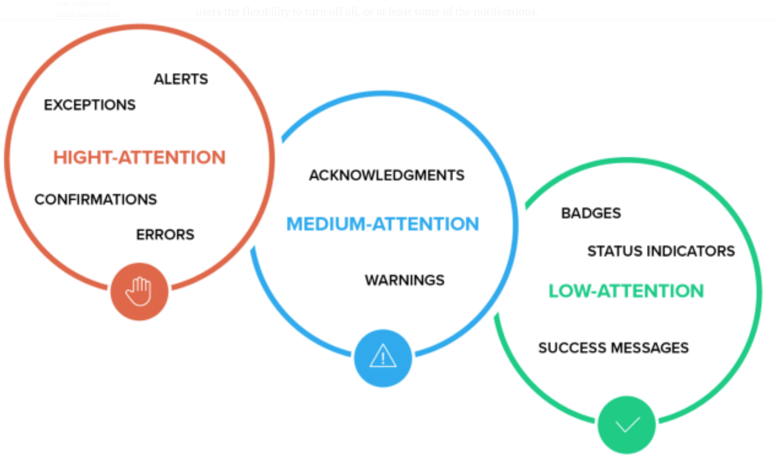
PHILIPS, M., 2020. A comprehensive guide to notification design [viewed 11 October 2020]. Available from: https://uxdesign.cc/a-comprehensive-guide-to-notification-design-2fff67f08b7a

Slide 9
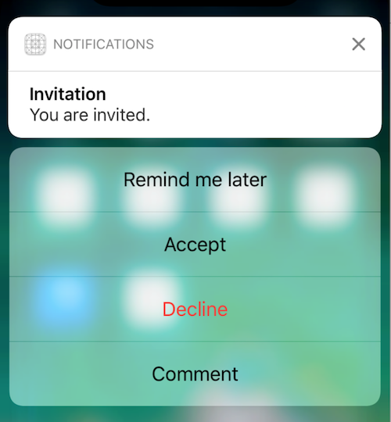
Actionable Notifications “Allow people to be productive without opening an app. Enabling users to accomplish small tasks without going into an app can be a powerful tool in enhancing UX.” (PHILIPS 2020)
PHILIPS, M., 2020. A comprehensive guide to notification design [viewed 11 October 2020]. Available from: https://uxdesign.cc/a-comprehensive-guide-to-notification-design-2fff67f08b7a

Slide 10
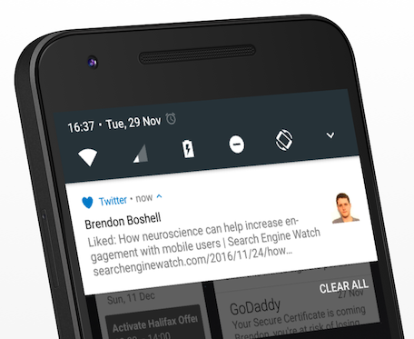
Push notifications
Push notifications allow developers to reach users, even when users aren’t actively using an app
BOSHELL.,B. 2016. Push Notifications: Guide to Segmentation, Personalization and More. In: Sweet Pricing Blog. 29 November 2016 [viewed 11 October 2020]. Available from: https://sweetpricing.com/blog/2016/11/push-notifications/

Slide 11
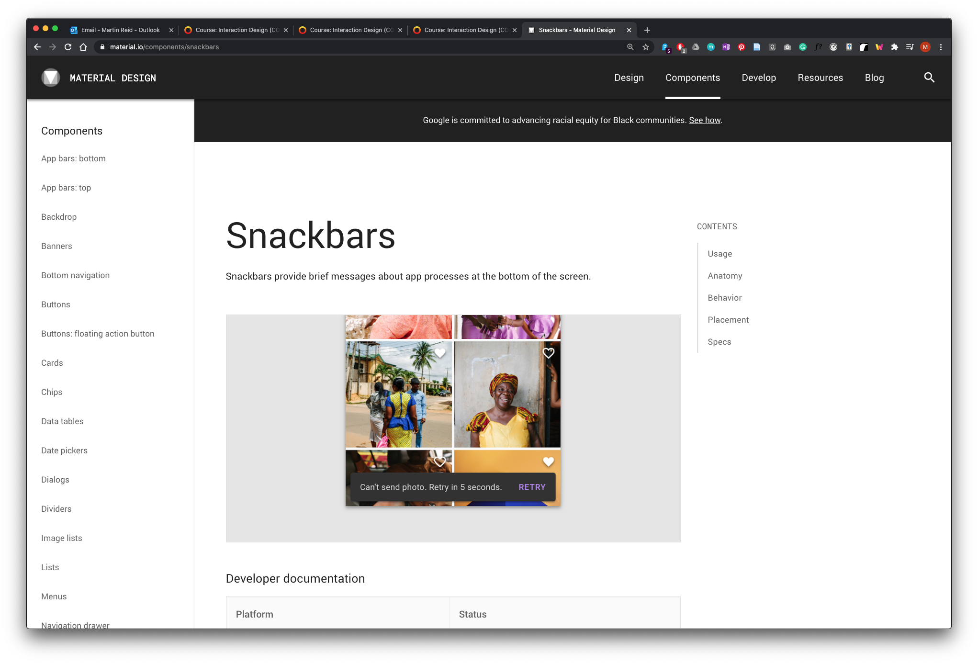
GOOGLE., 2020. Snackbars [viewed 11 October 2020]. Available from: https://material.io/components/snackbars

Slide 12
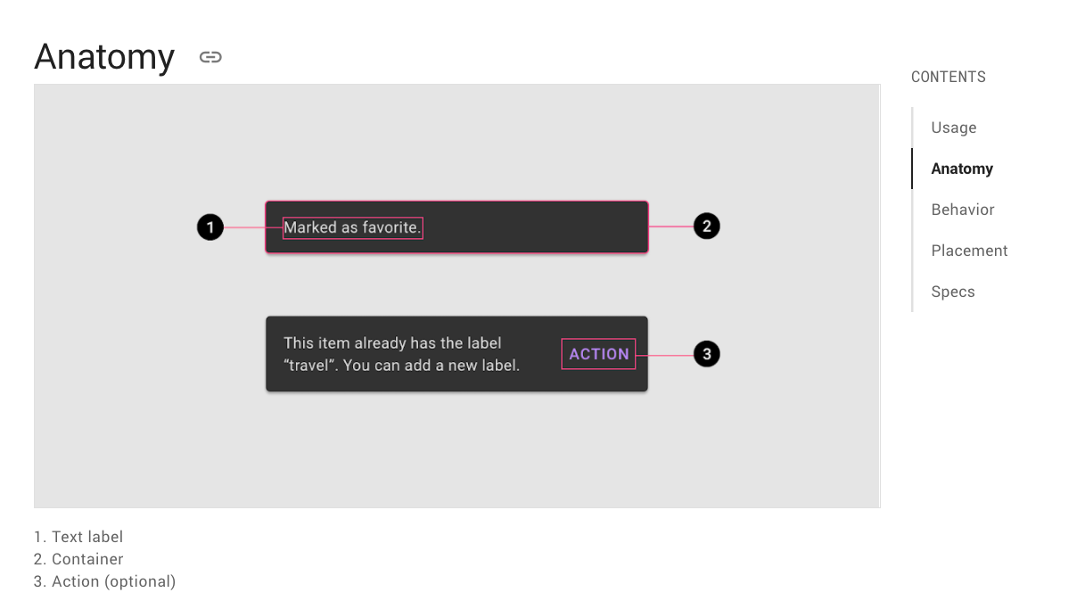
https://material.io/components/snackbars#anatomy

Slide 13
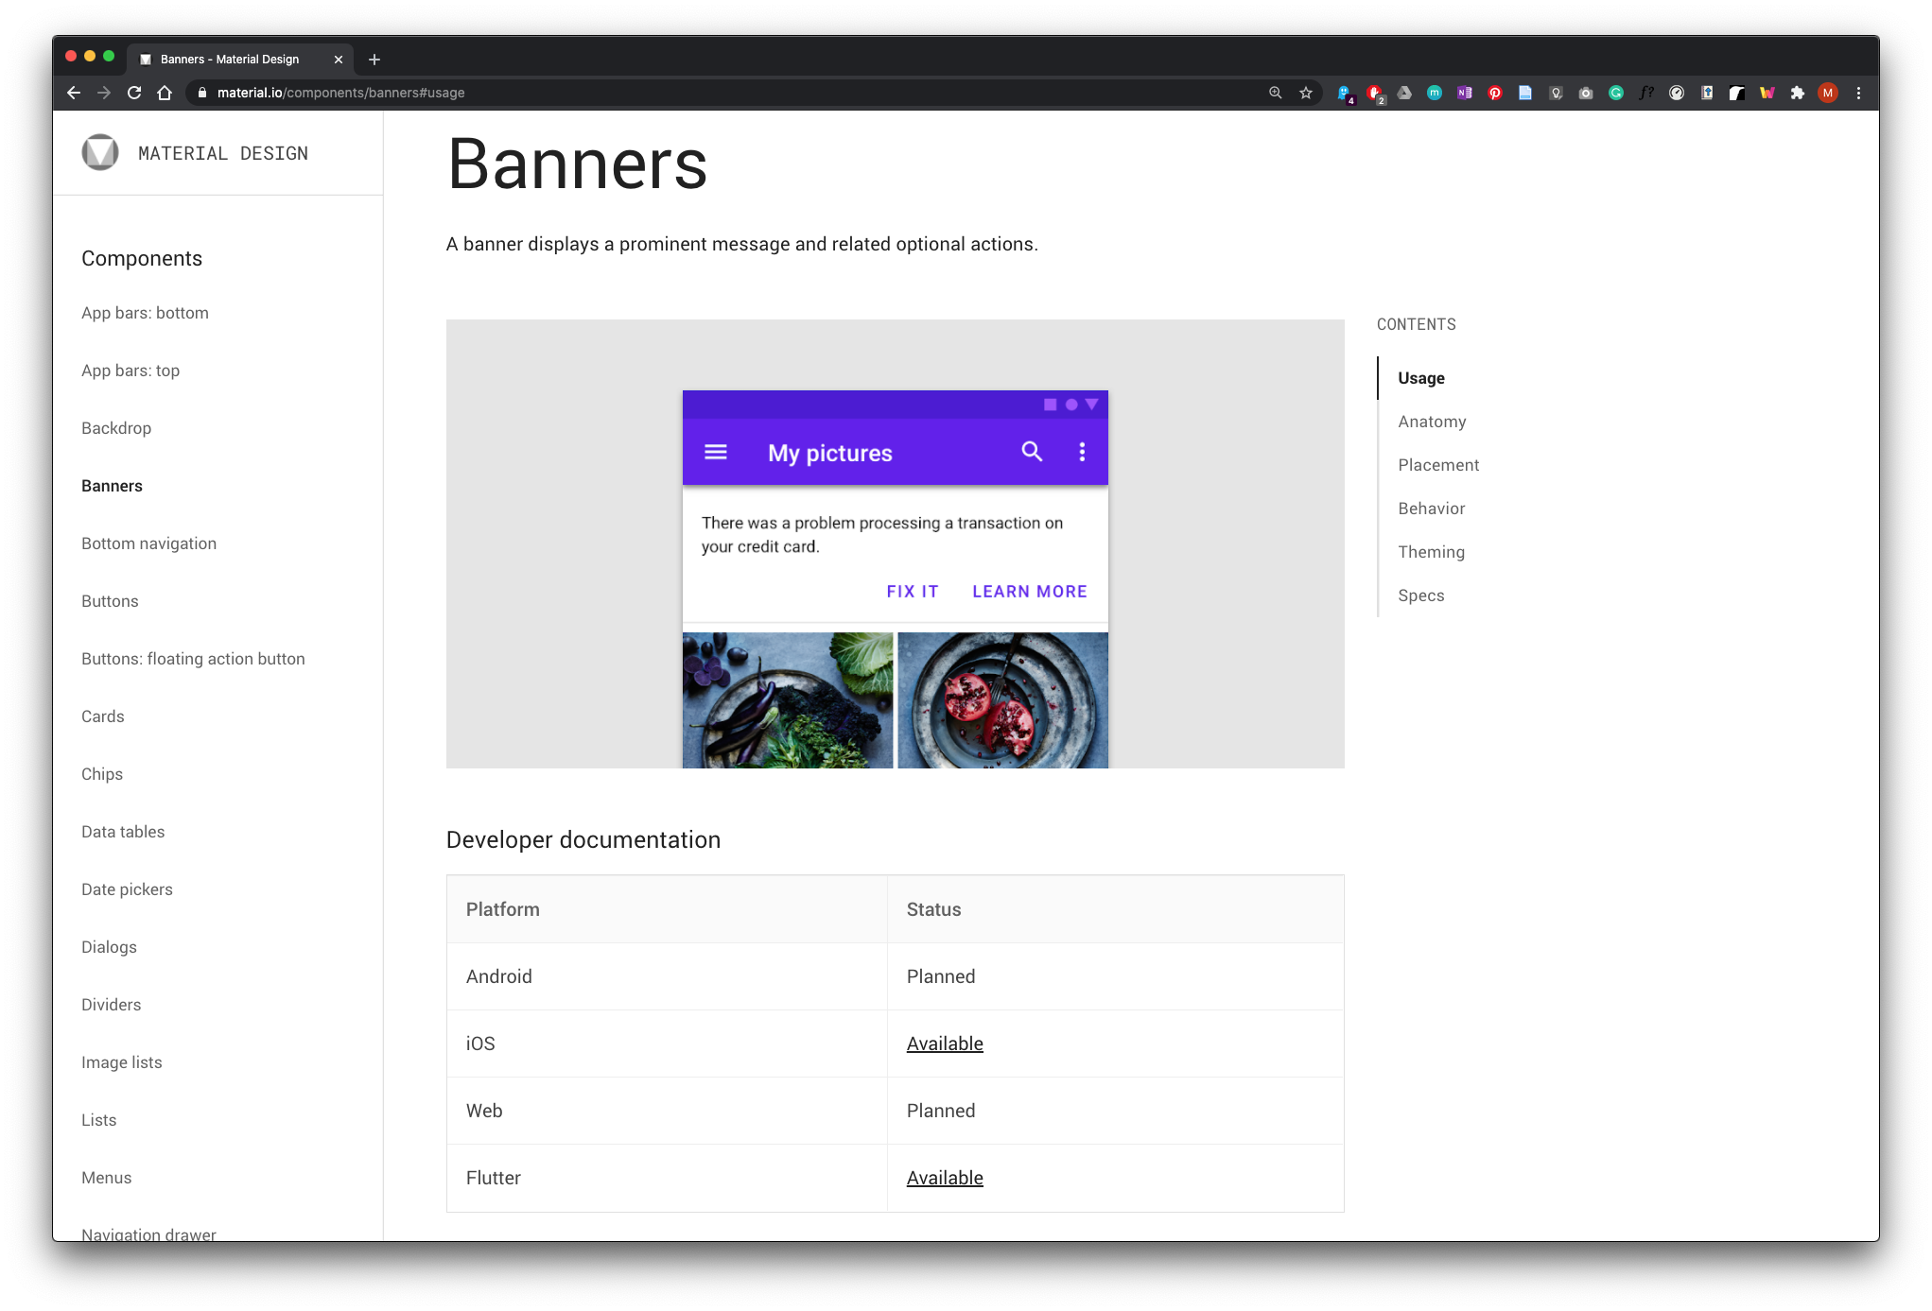
GOOGLE., 2020. Banners [viewed 11 October 2020]. Available from: https://material.io/components/banners#usage

Slide 14
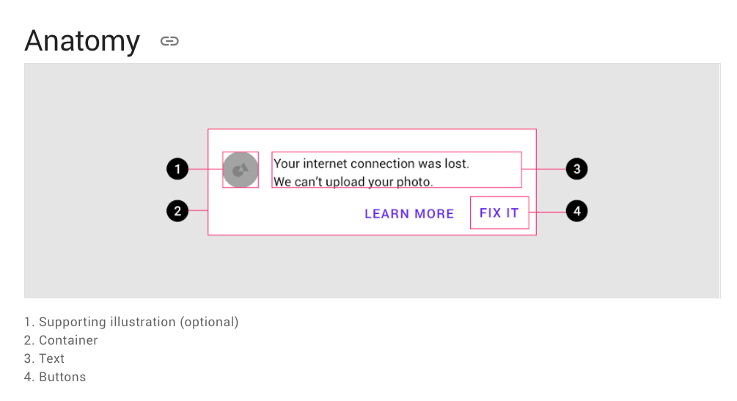
https://material.io/components/banners#anatomy

Slide 15
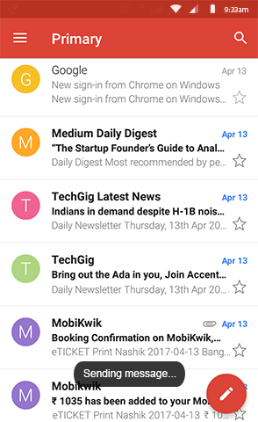
Toast Notification
Small message that shows up in a box at the bottom of the screen and disappears on its own after few seconds.
It informs the user of something that is not critical and that does not require specific attention and does not prevent the user from using the app device.
MUNOT, S., 2018. Toast Notification or Dialog Box? [viewed 11 October 2020]. Available from: https://uxplanet.org/toast-notification-or-dialog-box-ae32ad53106d

Slide 16
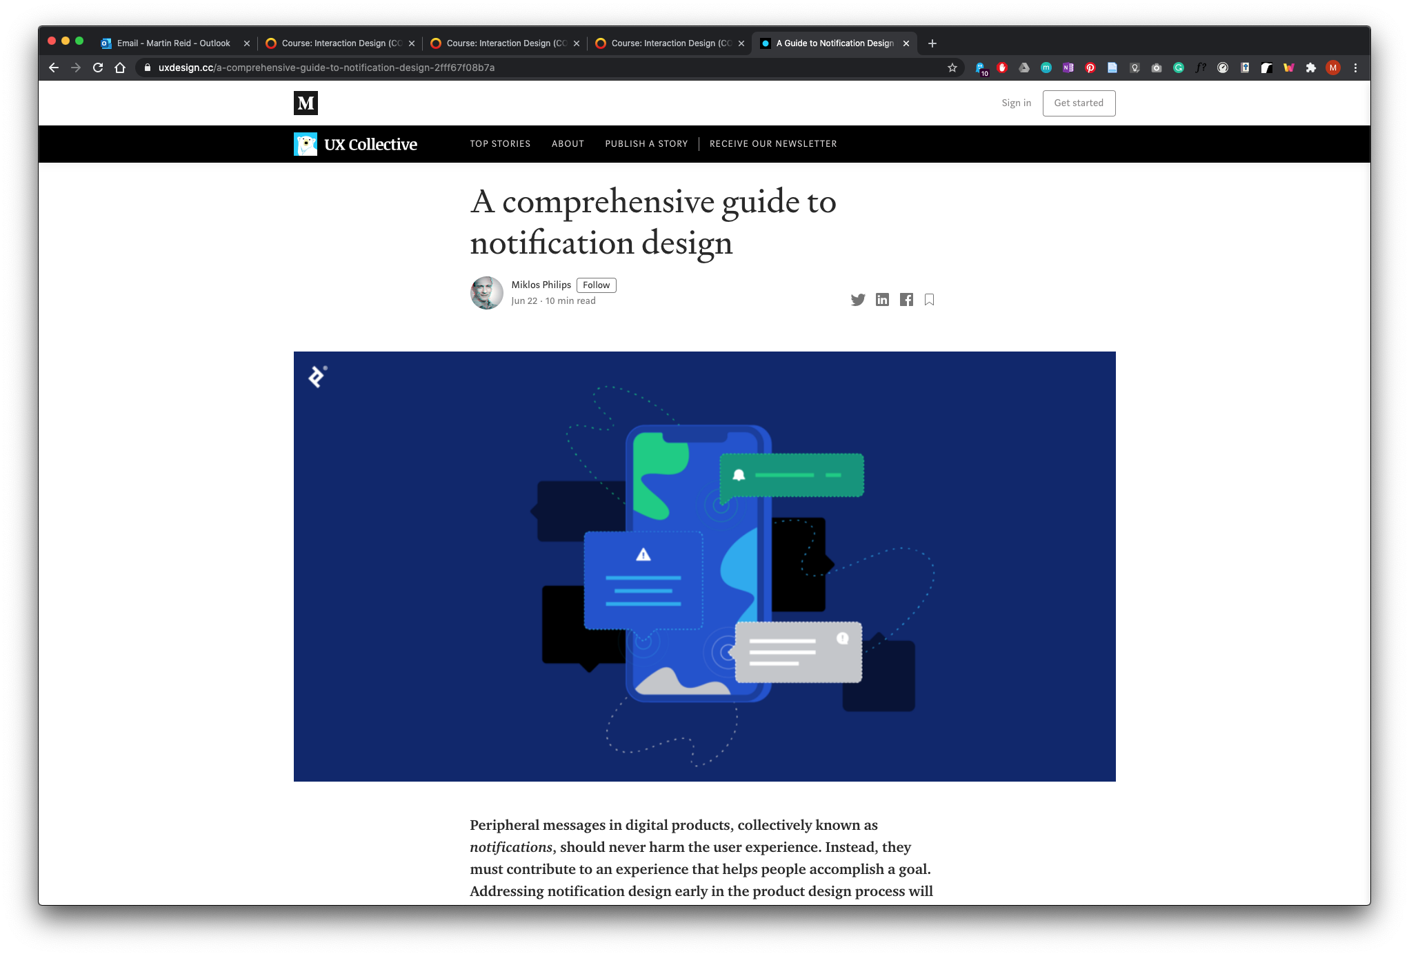
PHILIPS, M., 2020. A comprehensive guide to notification design [viewed 11 October 2020]. Available from: https://uxdesign.cc/a-comprehensive-guide-to-notification-design-2fff67f08b7a

Slide 17
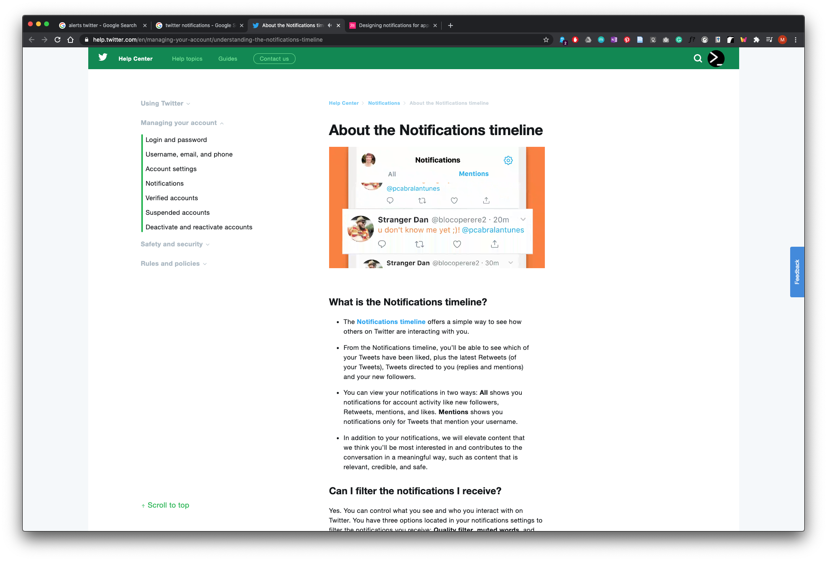
TWITTER., 2020. About the Notifications timeline [viewed 11 October 2020]. Available from: https://help.twitter.com/en/managing-your-account/understanding-the-notifications-timeline

Slide 18
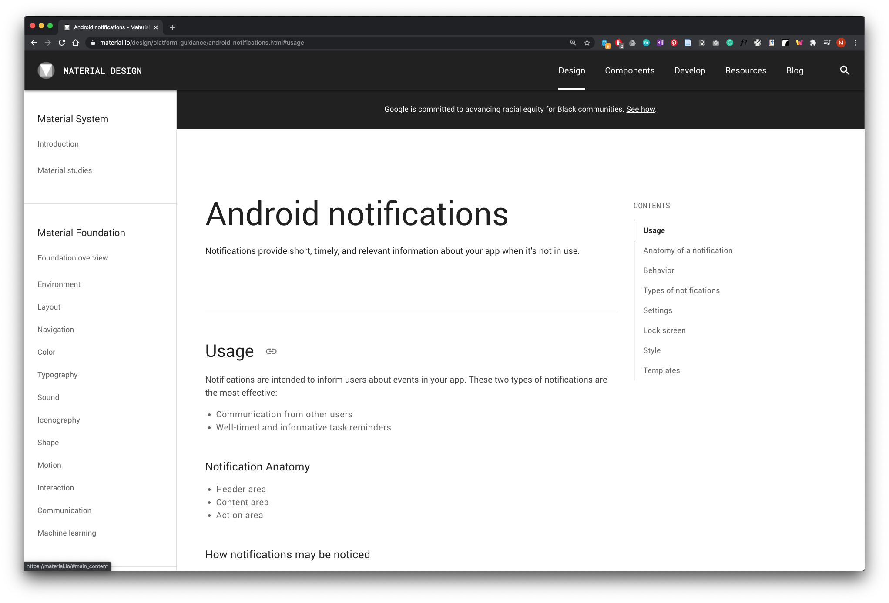
GOOGLE., 2020. Android notifications [viewed 11 October 2020]. Available from: https://material.io/design/platform-guidance/android-notifications.html#usage

Slide 19
Notifications are intended to inform users about events in your app. Communication from other users
Well-timed and informative task reminders

Slide 20
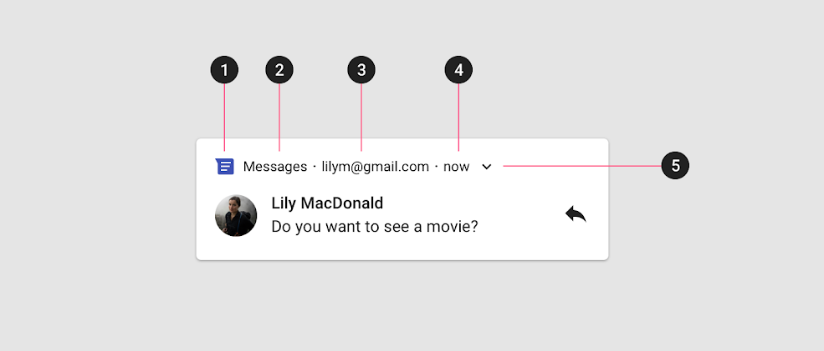
Header area
1.App icon 2. App name 3.Header text 4.Timestamp 5.Expand indicator
GOOGLE., 2020. Android notifications [viewed 11 October 2020]. Available from: https://material.io/design/platform-guidance/android-notifications.html#usage

Slide 21
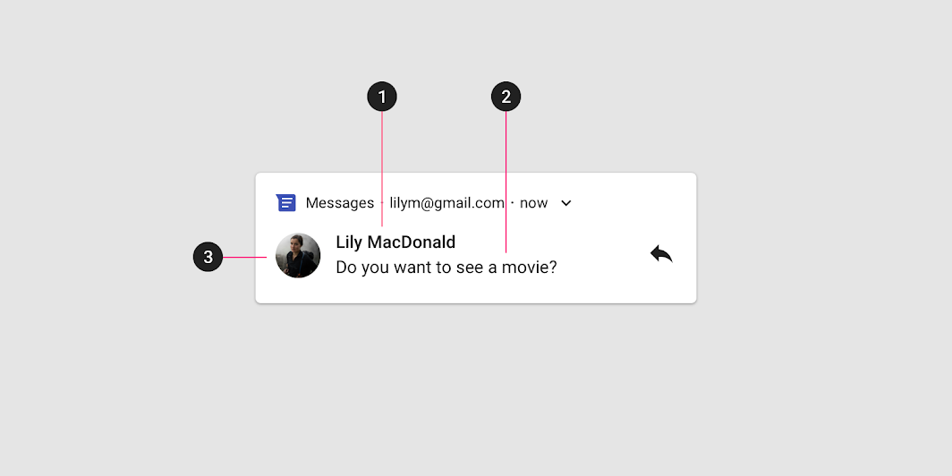
Content area
1.Contact title 2.Content text 3.Large icon
GOOGLE., 2020. Android notifications [viewed 11 October 2020]. Available from: https://material.io/design/platform-guidance/android-notifications.html#usage

Slide 22
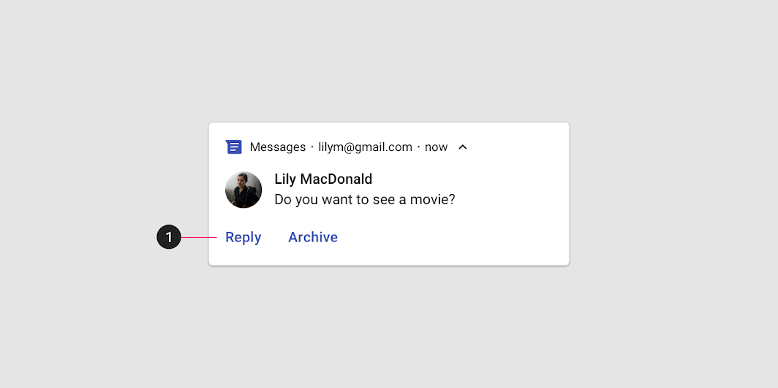
Action area
1.Action area
GOOGLE., 2020. Android notifications [viewed 11 October 2020]. Available from: https://material.io/design/platform-guidance/android-notifications.html#usage

Slide 23
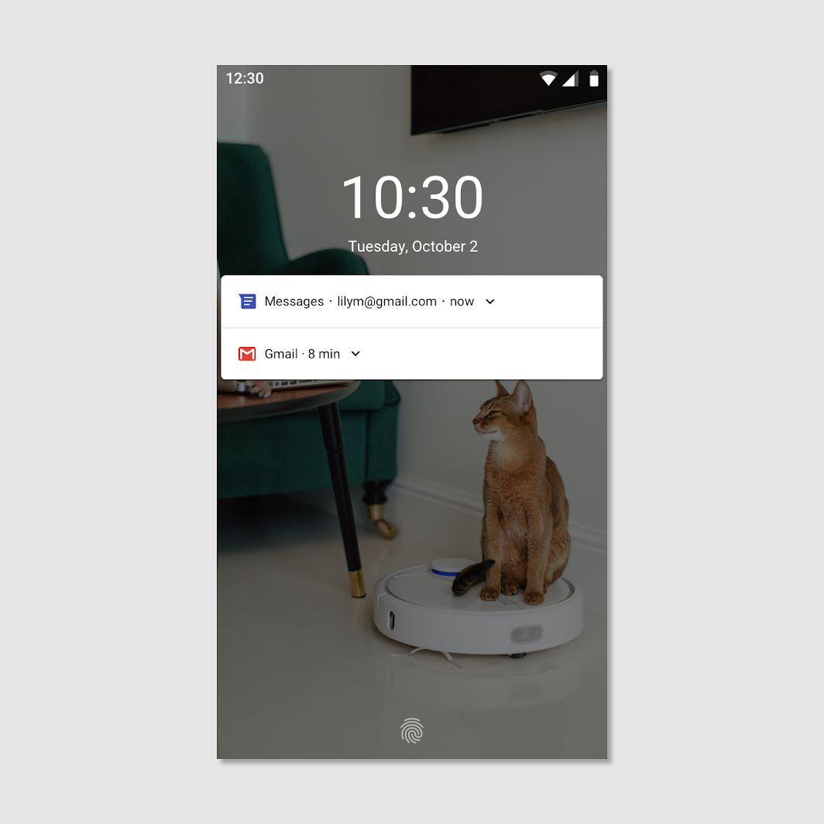
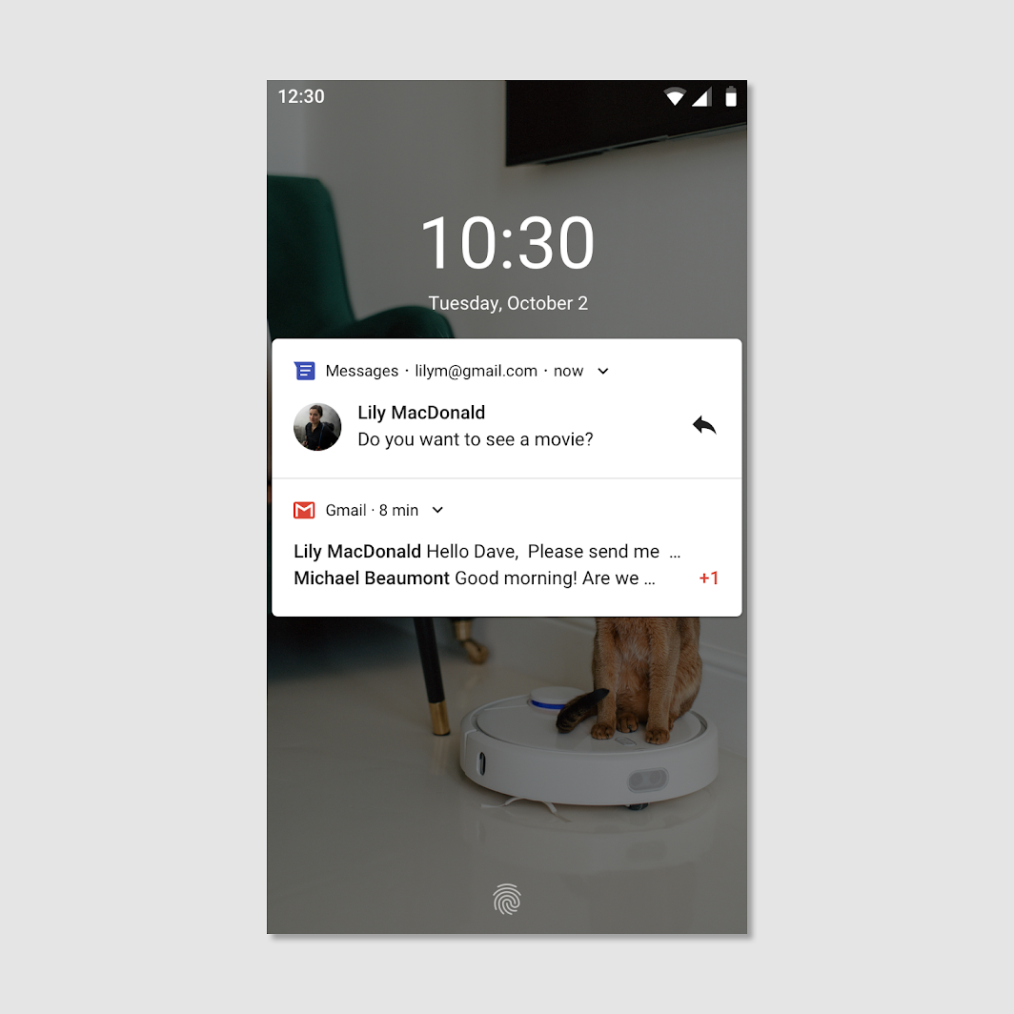
Lock Screen
Because notifications are visible on the lock screen, user privacy is an important consideration. Public notifications are fully visible on secure lock screens, while secret notifications are hidden
GOOGLE., 2020. Android notifications [viewed 11 October 2020]. Available from: https://material.io/design/platform-guidance/android-notifications.html#usage

Slide 24
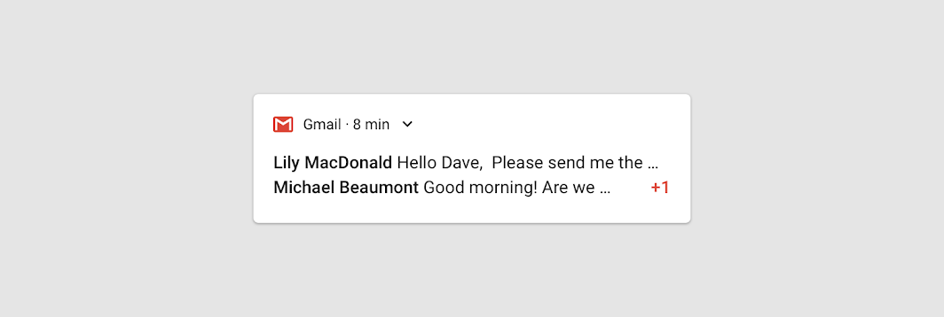
Action area
Because notifications are visible on the lock screen, user privacy is an important consideration. Public notifications are fully visible on secure lock screens, while secret notifications are hidden
GOOGLE., 2020. Android notifications [viewed 11 October 2020]. Available from: https://material.io/design/platform-guidance/android-notifications.html#usage

Slide 25
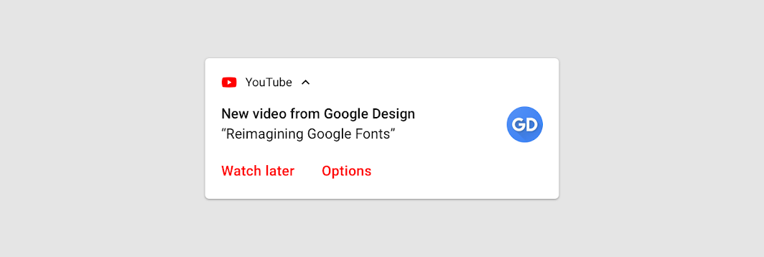
Opt-In
This notification from YouTube takes the opt-out approach. It offers both context (a YouTube channel the user has subscribed to) and value (a new video from that channel). The "Options" action navigates the user to where they can opt out of future notifications for this channel.
GOOGLE., 2020. Android notifications [viewed 11 October 2020]. Available from: https://material.io/design/platform-guidance/android-notifications.html#usage

Slide 26
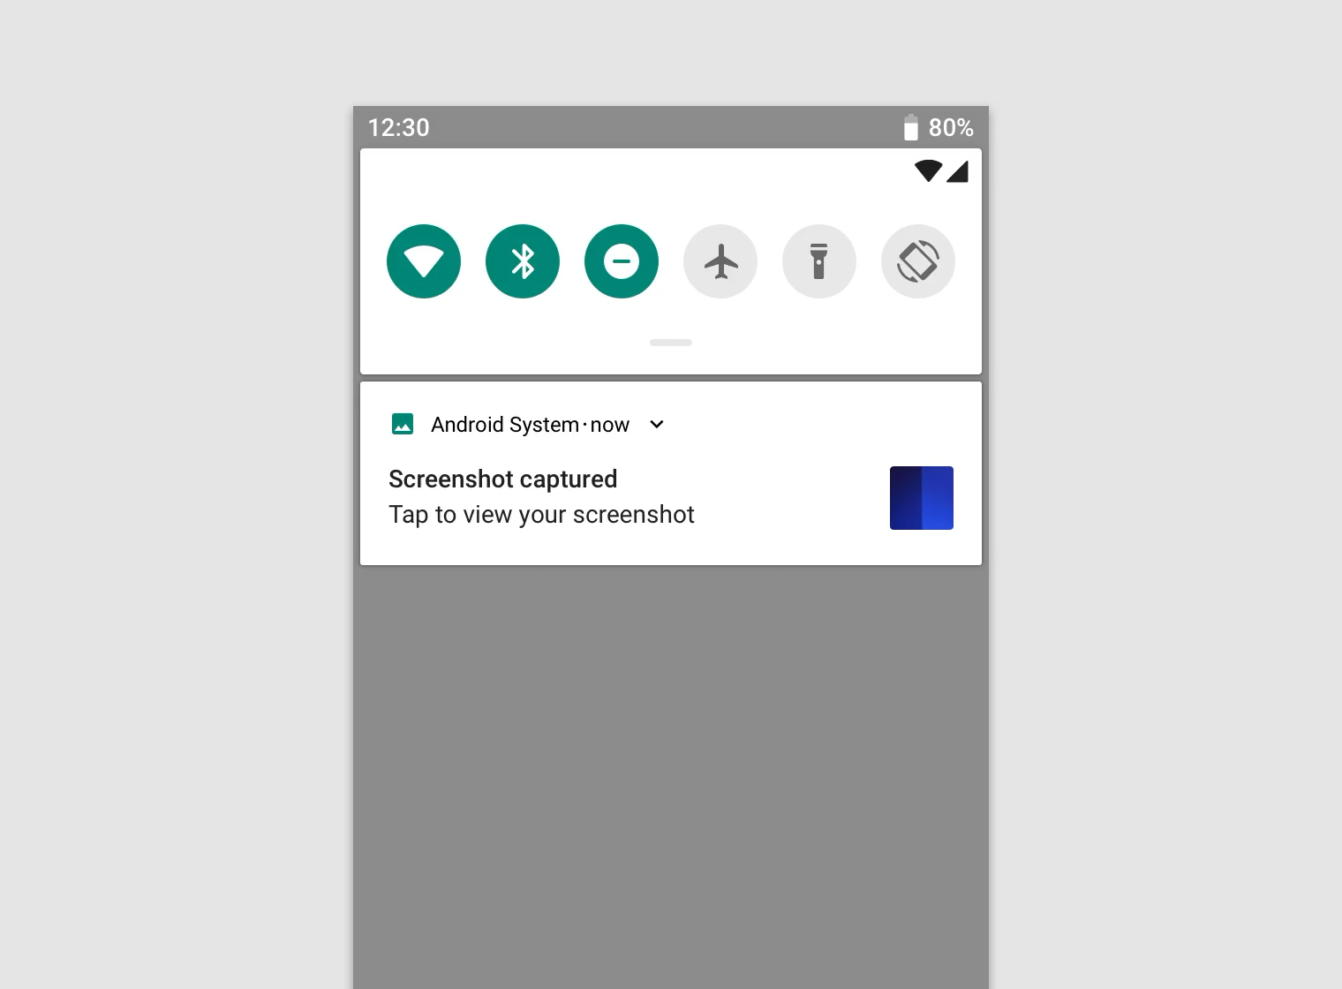

Slide 27
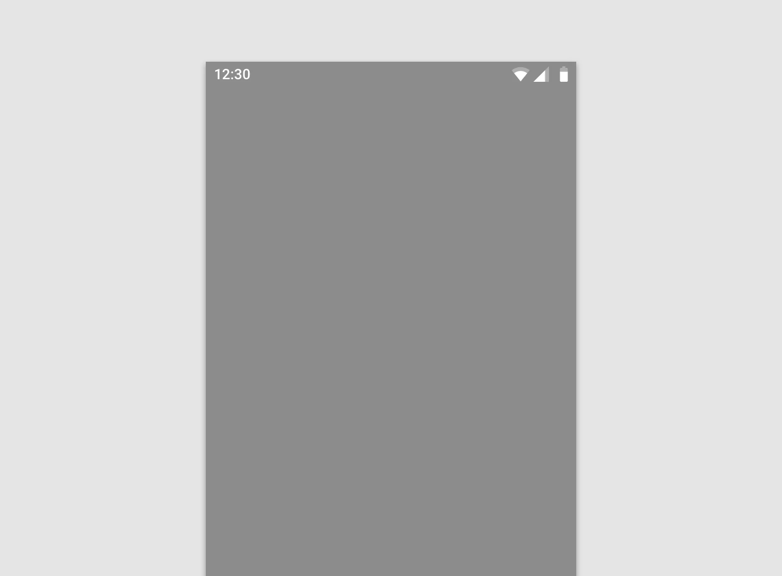

Slide 28
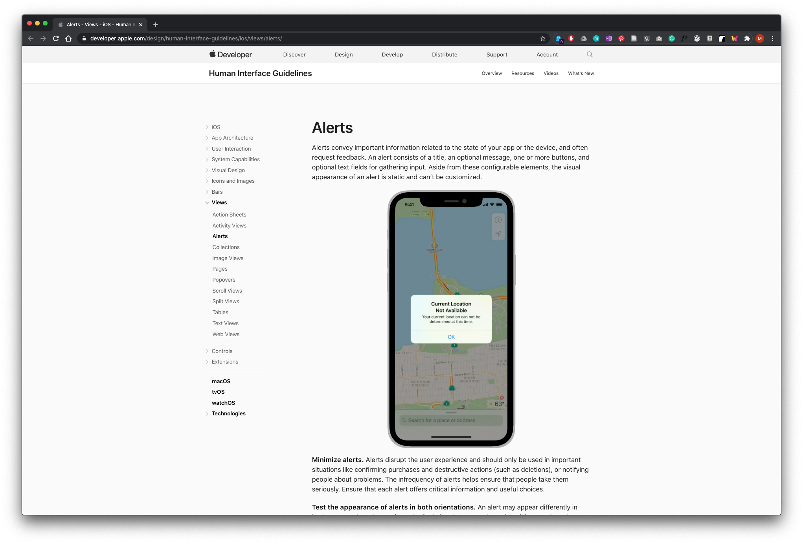
APPLE., 2020. Alerts - Views - iOS - Human Interface Guidelines - Apple Developer [viewed 11 October 2020]. Available from: https://developer.apple.com/design/human-interface-guidelines/ios/views/alerts/

Slide 29
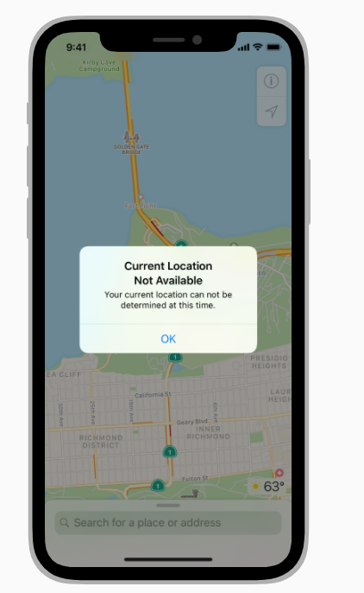
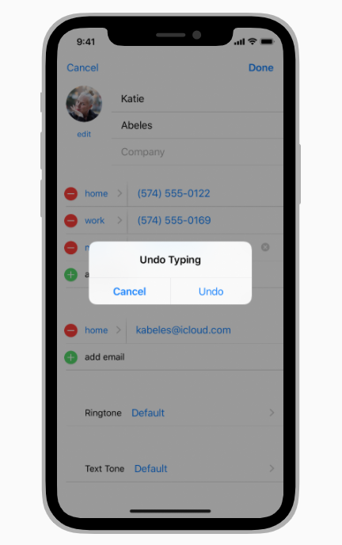
Alerts Apple
Alerts convey important information related to the state of your app or the device, and often request feedback. An alert consists of a title, an optional message, one or more buttons, and optional text fields for gathering input.
APPLE., 2020. Alerts - Views - iOS - Human Interface Guidelines - Apple Developer [viewed 11 October 2020]. Available from: https://developer.apple.com/design/human-interface-guidelines/ios/views/alerts/

Slide 30
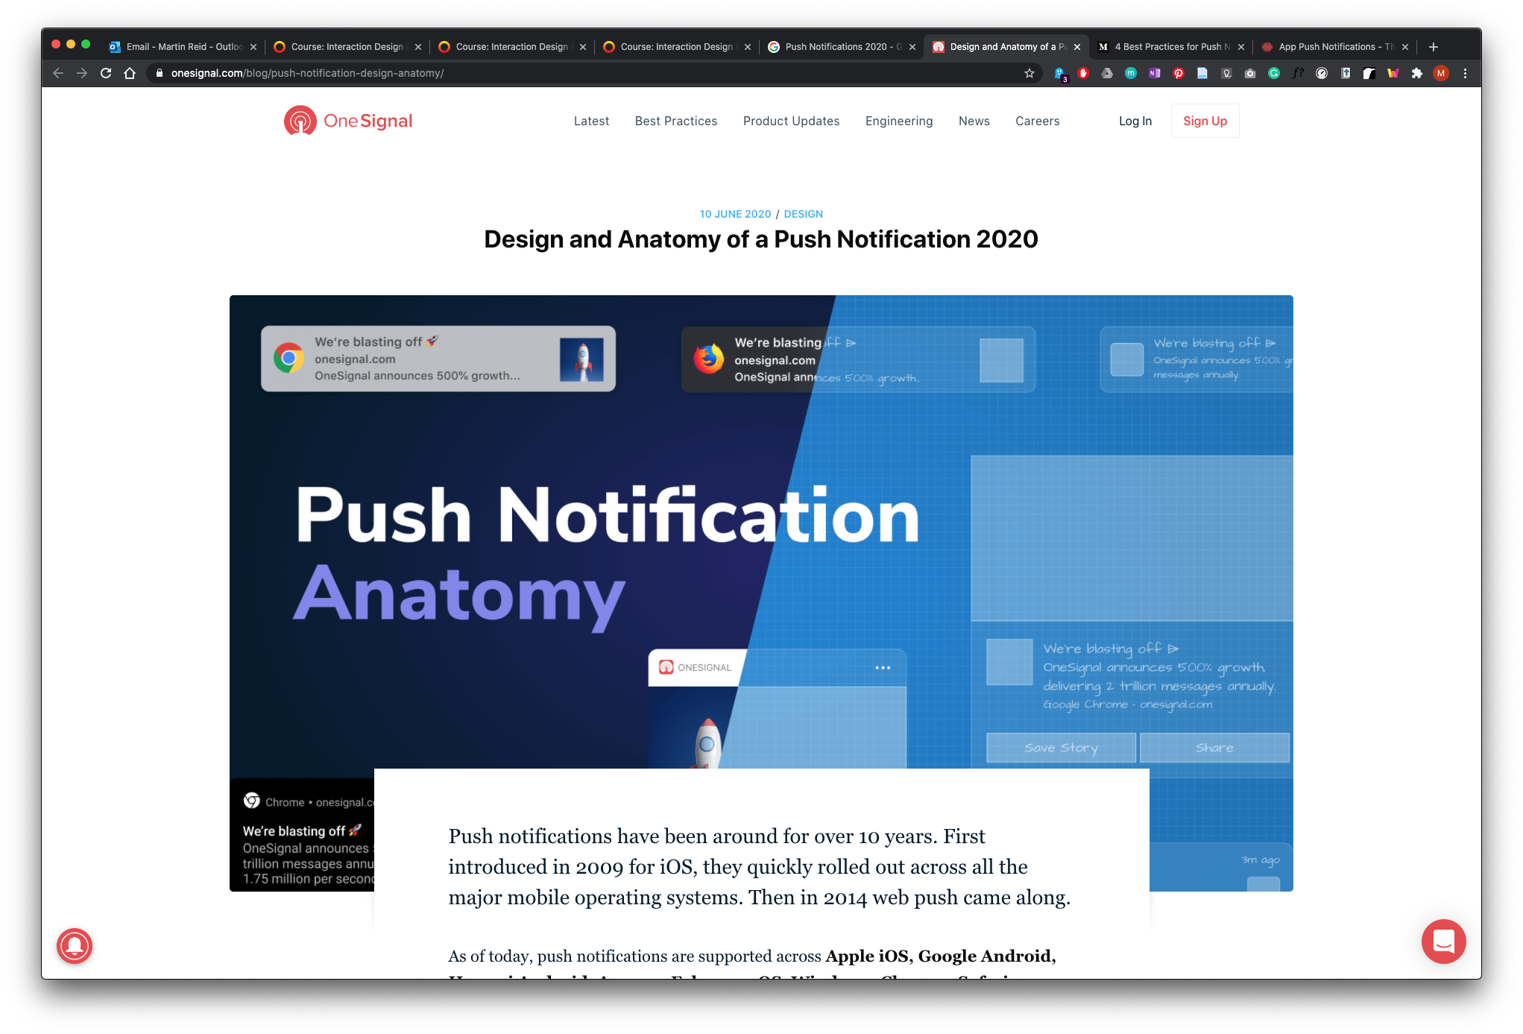
ONESIGNAL., 2020. Design and Anatomy of a Push Notification 2020 [viewed 11 October 2020]. Available from: https://onesignal.com/blog/push-notification-design-anatomy/

Slide 31
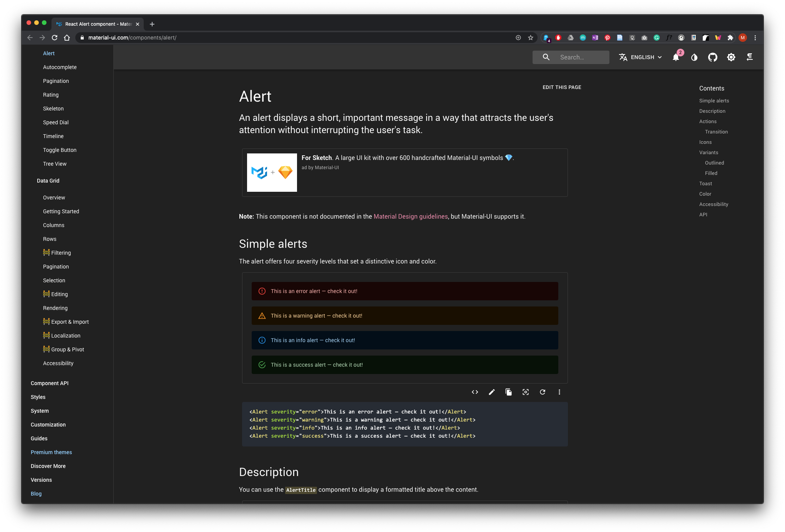
Material-UI., 2020. React Alert component - Material-UI [viewed 11 October 2020]. Available from: https://material-ui.com/components/alert/

Slide 32
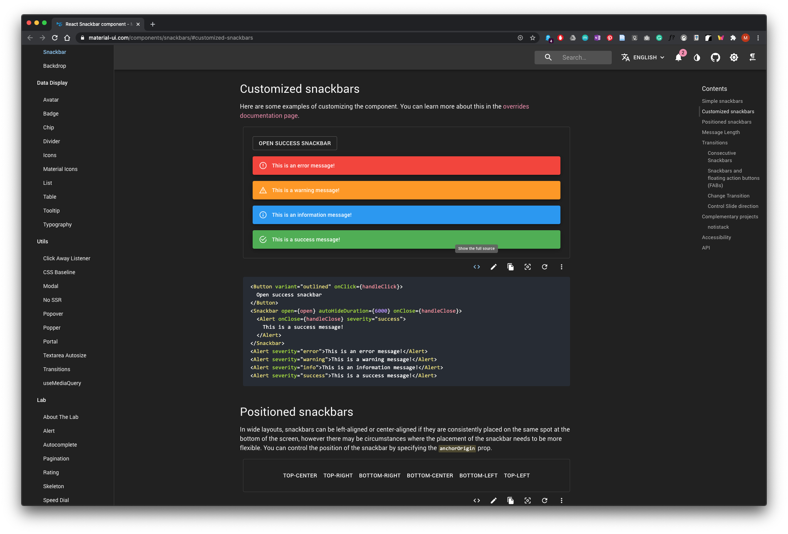
MATERIAL-UI., 2020. React Snackbar component - Material-UI [viewed 11 October 2020]. Available from: https://material-ui.com/components/snackbars/#customized-snackbars

